Slide 1
Mapping +Delineating Horsepen Creek Watershed

Slide 2
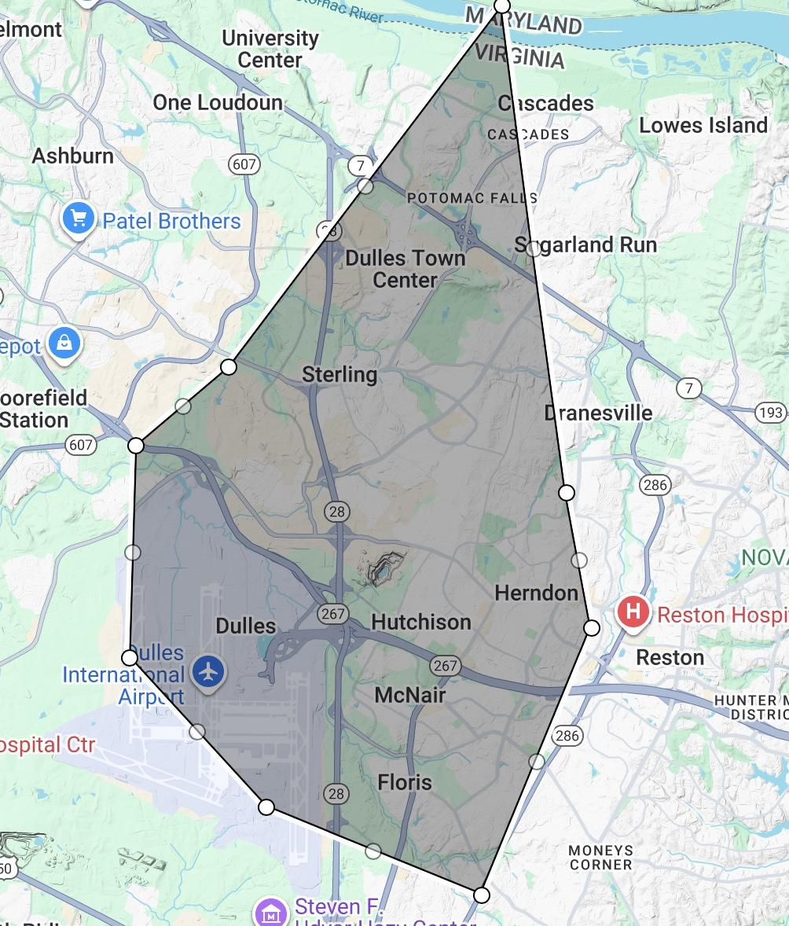
Map of Watershed

Slide 3
Physical Characteristics
23.5 Overall Square Miles
Overall Change in Altitude→ ~520 Ft Above Sea level

Slide 4
Watershed Features
Major Tributaries → Cedar Run, Frying Pan Branch, and some unnamed streams
Major Towns→ Herndon, Dulles, Floris, McNair
  Herndon borders Sugarland Run Watershed as well
Major Counties → Fairfax County, Loudoun County
Other Signf. Features→ Part of Horsepen Run is under Dulles Int. Airport, and Frying Pan Park, and cuts thru Fairfax Co. Parkway

Slide 5
References
Curtis, S. (2025). Sugarland Run and Horsepen Creek Watersheds. Fairfax County Virginia. https://www.fairfaxcounty.gov/publicworks/stormwater/sugarland-run-and-horsepen-creek-watersheds
Fairfax County. (2017). GEOLOGY AND TOPOGRAPHY. Fairfax County Comprehensive Plan 2017 Edition - Policy Plan . https://online.encodeplus.com/regs/fairfaxcounty-va-cp/doc-viewer.aspx?secid=359#secid-359
GoogleMyMaps, & Sanfield, S. (2025, December 11). Horsepen Creek Watershed Map. Google accounts. https://www.google.com/maps/d/u/0/edit?mid=1WQJoADxQncG3DrCKRSHIgpTZfG-ehjo&ll=38.9944134747451%2C-77.44381609056232&z=12

