Slide 1
Horsepen Creek Watershed
Floodplain Maps

Slide 2
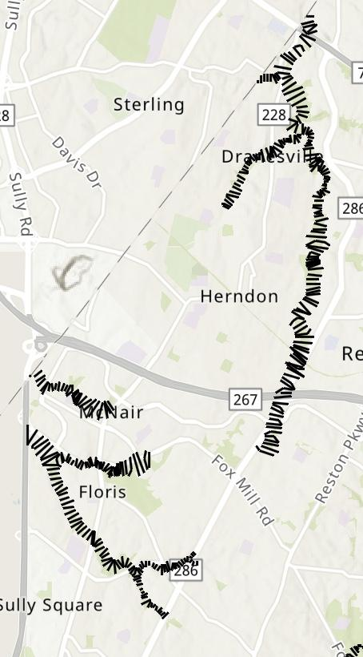
Floodplain Cross Sections Map
The black lines indicate the floodplain cross sections in the Horsepen Creek Watershed.
You can use the map below to show more of the surrounding areas, and near Dulles Airport.
Click on Interactive Map showing more around floodplain cross sections around Dulles Airport, and other Fairfax and Loudon County watersheds.

Slide 3
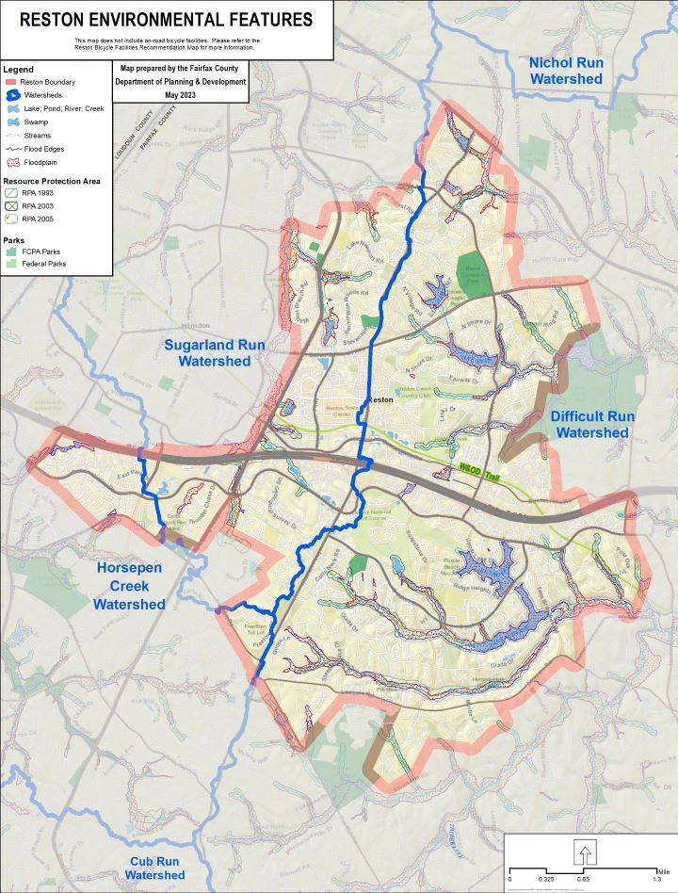
Floodplain, and Environmental Features Map
You can take a broader look of the map here, including the other watersheds of the counties.

Slide 4
|References
Fairfax County. (2017a). Environmental Stewardship. Fairfax County Comprehensive Plan. https://online.encodeplus.com/regs/fairfaxcounty-va-ap/doc-viewer.aspx?secid=2508#secid-2508.

