Slide 1
Horsepen Creek Watershed
Special Threats

Slide 2
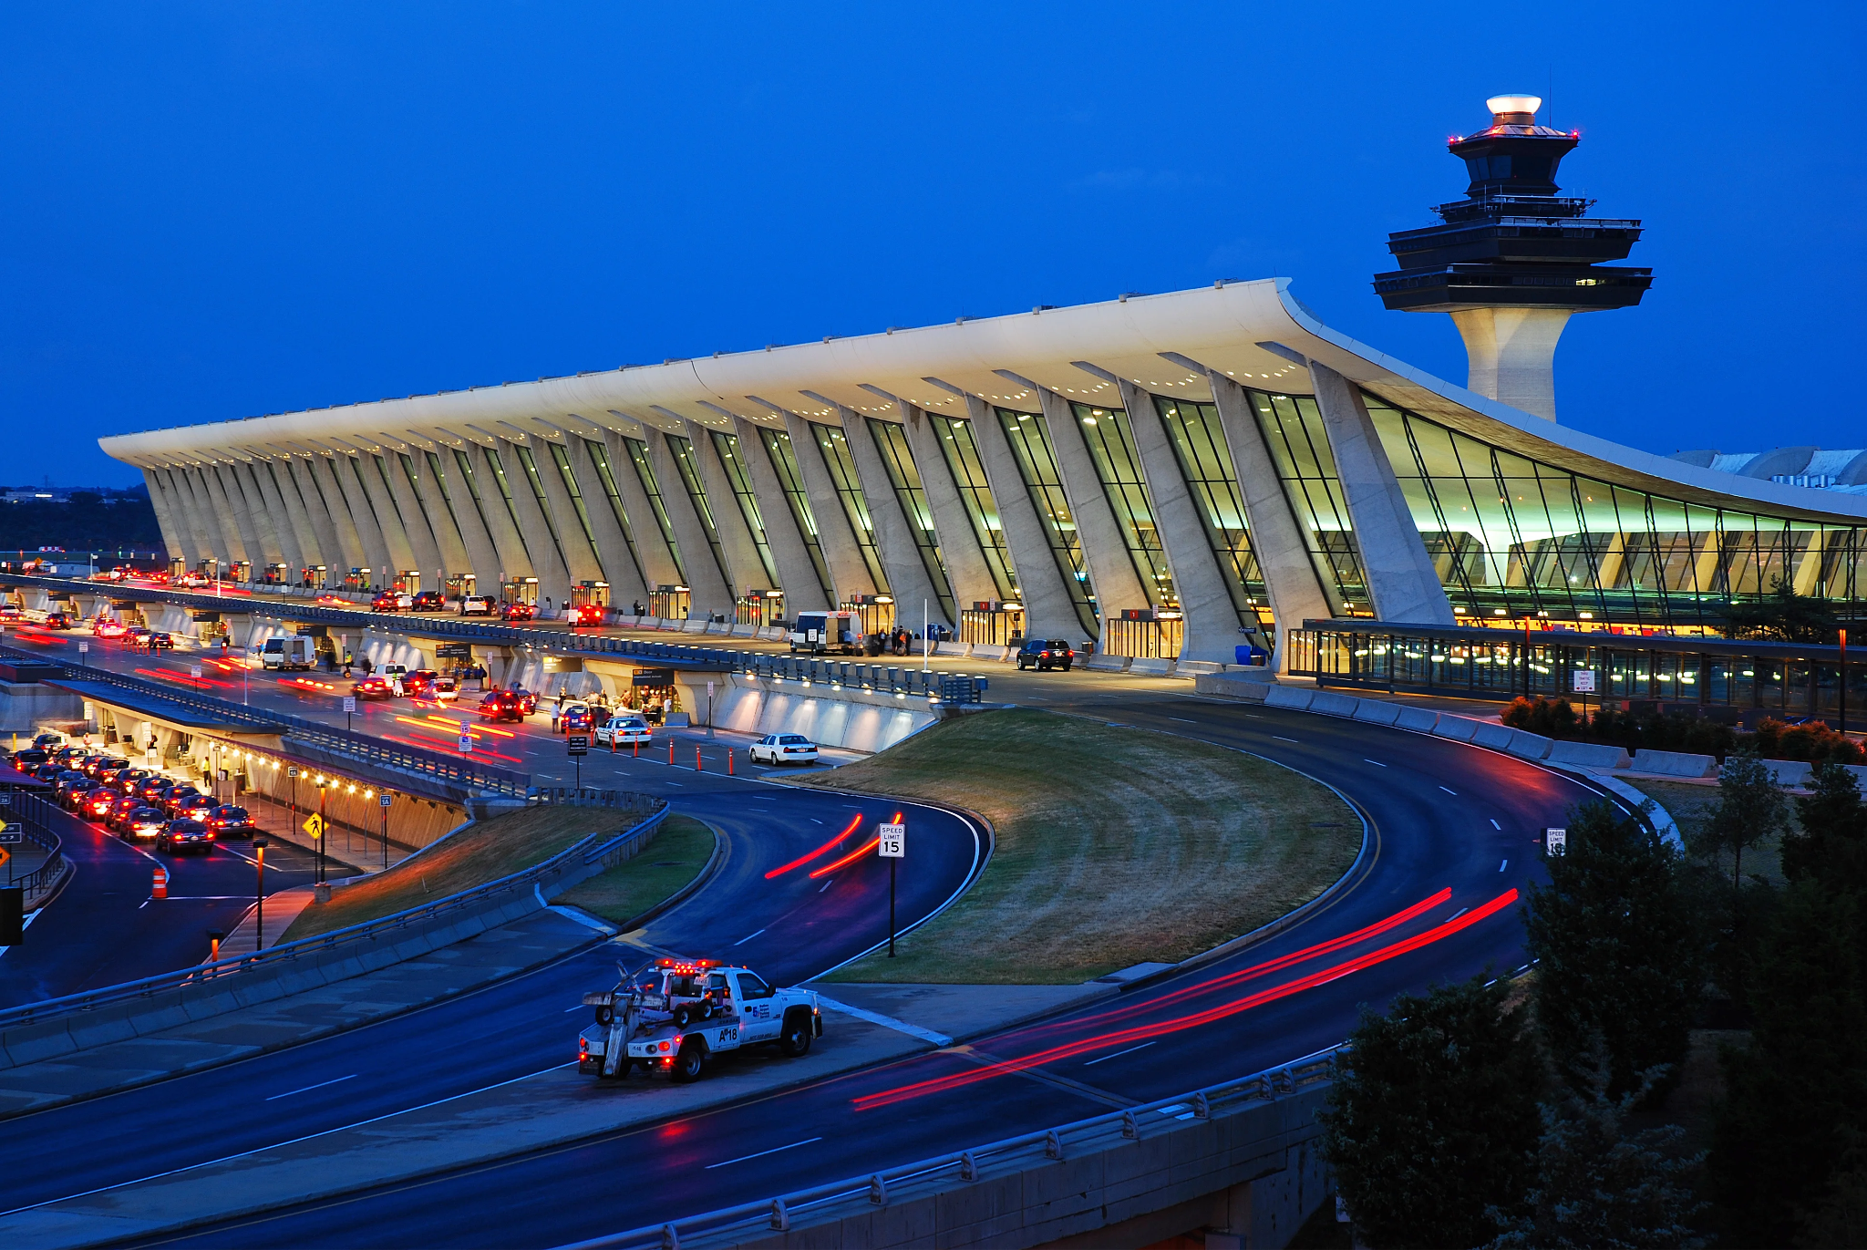
Runoff
The watershed is subject to runoff from Dulles International Airport, as well as the urban landscape of Dulles and Herndon, as the watershed notably runs through these areas. Gasoline and oil from cars and planes can make its way into waterways.

Slide 3
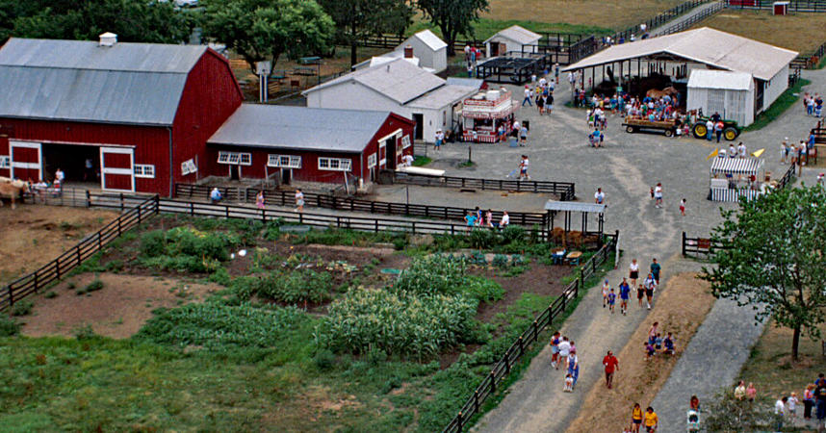
Runoff Cont.
The Horsepen Creek Watershed goes through Frying Pan Park. Animal waste, and any agents used on the crops can also runoff into water streams and can cause algae blooms from excess nutrients.

Slide 4
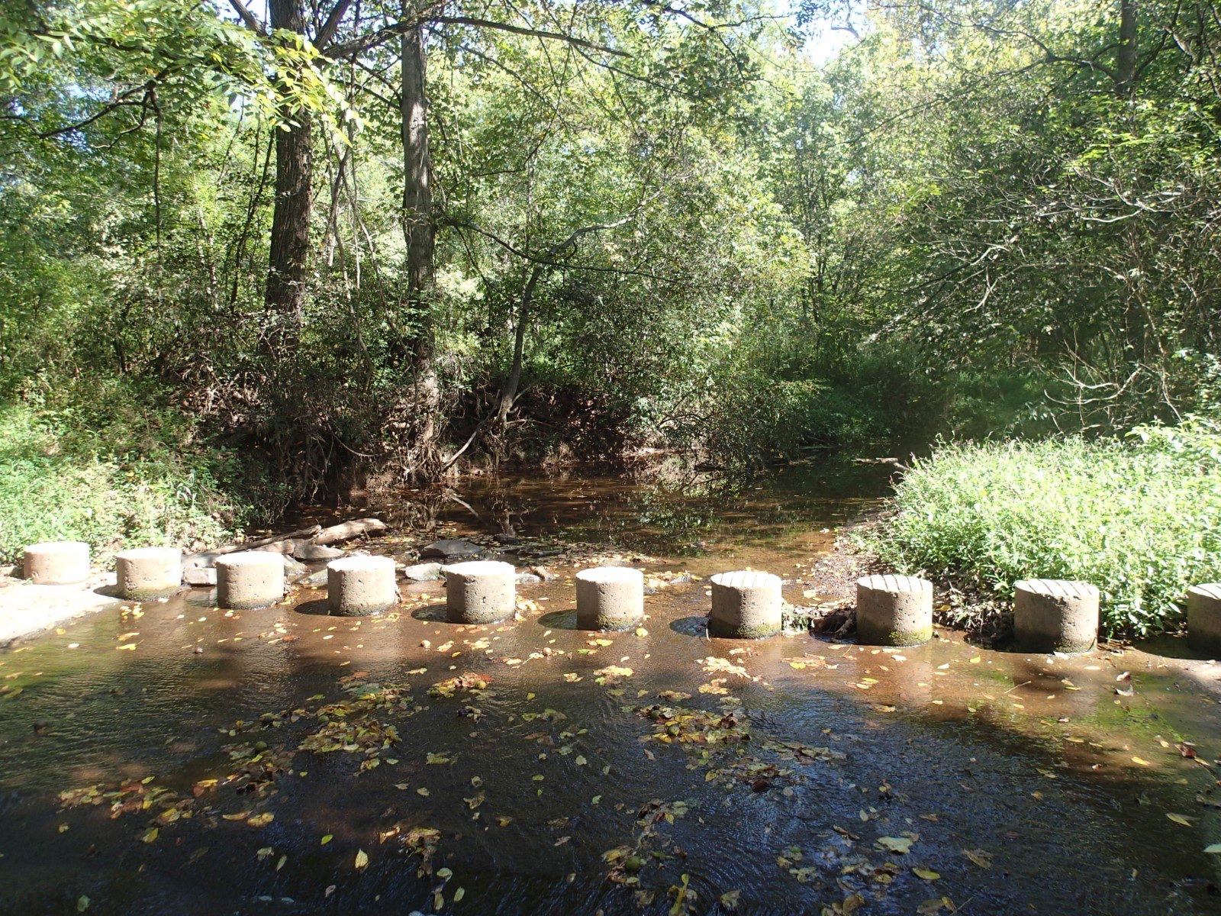
Human Disturbances
With specific trails neighboring streams and tributaries of the watershed, human disturbances can also be a threat to the watershed. Waste not picked up by pets can cause runoff, as well as if humans tamped with native plants or wildlife.

Slide 5
|References
Reston Station. (n.d.). Frying Pan Park. photograph.
Hussain, A. (2025). Dulles International Airport . photograph, Dulles International Airport .
Sanfield, S. (2025). Horsepen Run Trailhead Trees and Shrubs. photograph, Horsepen Run Trailhead.

