Slide 1
Horsepen Creek Watershed
Special Characteristics
Sarah Sanfield

Slide 2
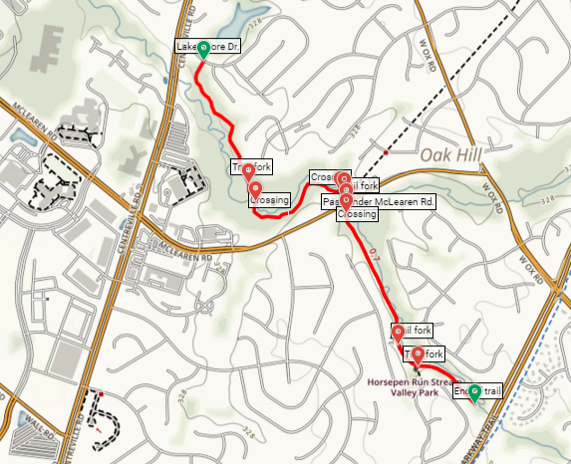
Horsepen Run Trailhead
This is a 1.5 Mile path, or 3 mile down and back path that takes you along Horsepen Run, a stream also covering tributaries within the Horsepen Creek Watershed. The path keeps you in the woods, in which are protected.

Slide 3
Horsepen Run Trailhead
This is a 1.5 Mile path, or 3 mile down and back path that takes you along Horsepen Run, a stream also covering tributaries within the Horsepen Creek Watershed. The path keeps you in the woods, in which are protected.

Slide 4
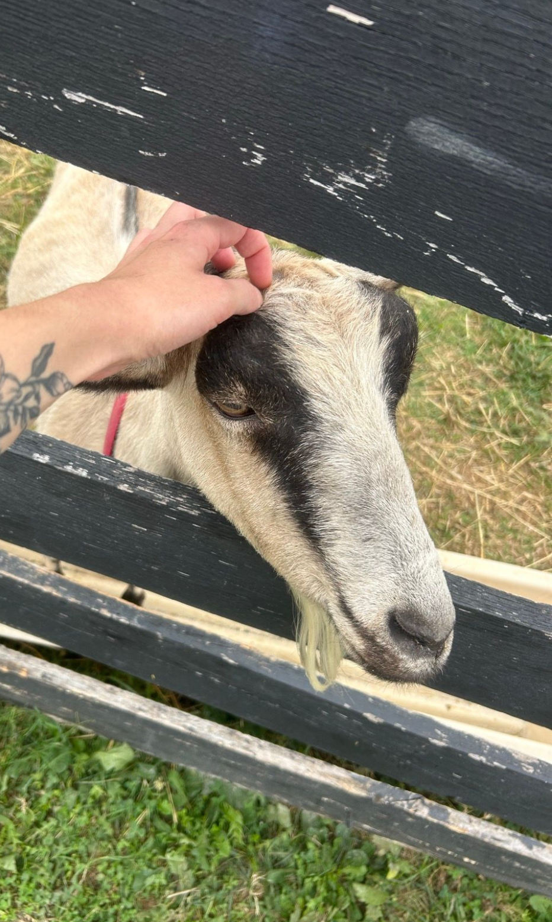
Frying Pan Farm Park
Frying Pan Park is an important landmark that the Horsepen Creek Watershed goes through. It holds a lot of importance for the community: it is a functioning farm, it has a preschool (where I went, haha), it is a historical landmark and preservation of farm life between the 1920s and 1950s, and it brings together community members for different events, equestrian, or even for walking paths.

Slide 5
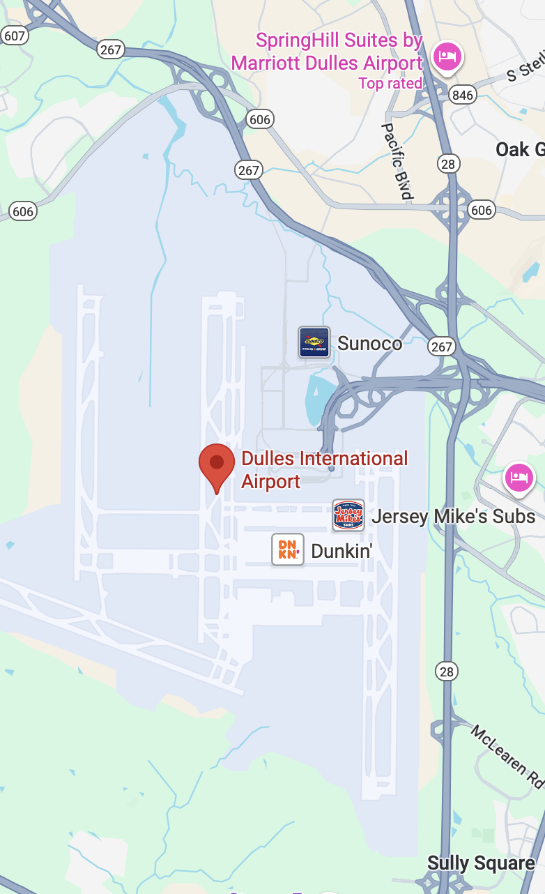
Dulles Airport
Another significant landmark that the Horsepen Creek Watershed crosses through is the Dulles International Airport. Waterways and streams breach from the Potomac and across the airport property. This makes the watershed susceptible to runoff with gas, oils, and other airport pollutants.

Slide 6
|References
Google Maps. (2025). Dulles Airport Google Maps. photograph, Dulles Airport.
Fairfax County. (2025c). Frying Pan Farm Park. Fairfax County Virginia. https://www.fairfaxcounty.gov/parks/frying-pan-park/
Hussain, A. (2025). Dulles International Airport . photograph, Dulles International Airport
Sanfield, S. (2025). Frying Pan Farm Goat photograph, Frying Pan Farm Park.
Wojtanik, A. (2025, August 31). Horsepen Run Trail (horsepen run stream Valley Park, VA). Live and Let Hike. https://liveandlethike.com/2016/02/28/horsepen-run-trail-horsepen-run-stream-valley-park-va/

