Slide 1
A Mile-A-Minute Weed
Invasive Species
Horsepen Creek Watershed

Slide 2
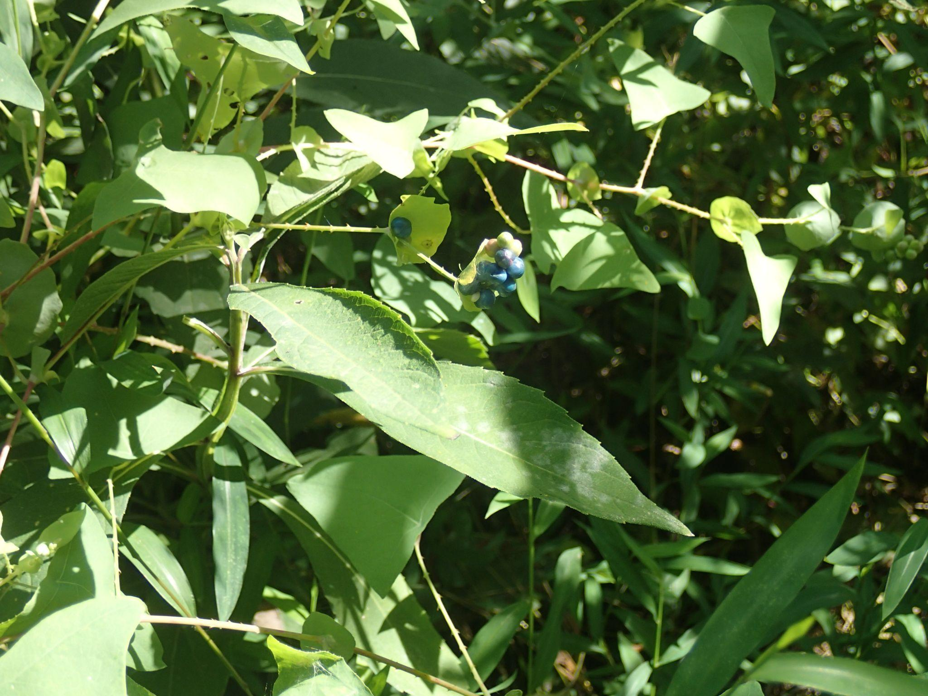
Overview of the Species
Common name→ Mile-A-Minute Weed
Family name→ Polygonaceae
Genus→ Persicaria
Species→ Perfoliata
Identification→Redish, spikey stems, indiv. shark tooth shaped, smooth textured leaves, dark blue berries

Slide 3
How did it get here?
The Mile-A-Minute weed is native to Asian countries, India, as well as the Philippines.
The first recorded sighting of this species in America was in the 1930s, in York County, Pennsylvania
It is reported that the weed accidentally arrived in America, as it contaminant in a nursery stock.

Slide 4
Species Characteristics
The Mile-A-Minute weed thrives in the full sunshine, but can also grow in the shade.
It is a herbaceous annual plant, meaning it dies off in the fall, and grows in the spring from seed germination.
The plant overtakes other native plants, similar to if you were to imagine the plant growing like a thick rug across the forest floor. They overtop natives, and dominate resources needed to survive.
The Mile-A-Minute weed is a self-pollinating plant, in which the plant grows seeds that spread easily. They are small and buoyant, which allows seeds to travel through waterways and spread far from its host. Seeds are also spread by birds.

Slide 5
How to Manage/Remove
Localized clusters of Mile-A-Minute weeds can be removed with gloves. Cutting at the stems and roots also reduces its growth. Matured weeds with seeds should be destroyed to avoid spread.
The Mile-A-Minute Weevil, a biological control agent specifically targeted for this weed, can stunt its plant growth by laying its eggs in the plant, and the larvae feeds on the plant until they pupate and drop into the soil.
Preemergence/Postemergence herbicides can also be used.
Eradication of the plant is difficult, but suppression has been seen successful to encourage the regrowth of native species.

Slide 6
References
Jackson, D., Wurzbacher, S., Gover, A., & Templeton, S. (2025, September 16). Mile-a-Minute. Penn State Extension. https://extension.psu.edu/mile-a-minute
New York Floral Association. (n.d.). New York Floral Atlas. Advanced Search - NYFA: New York Flora Atlas. https://newyork.plantatlas.usf.edu/search.aspx
Sanfield, S. (2025). Horsepen Run Trailhead Trees and Shrubs. photograph, Horsepen Run Trailhead.
University of Maryland Extension. (2025, April 16). Mile-a-Minute. https://extension.umd.edu/resource/mile-minute/
USDA. (2023). Mile-A-minute weed. National Invasive Species Information Center. https://www.invasivespeciesinfo.gov/terrestrial/plants/mile-minute-weed
VT Dendrology. (n.d.). Virginia Tech Dendrology Factsheets. Dendro.cnre.vt.edu. https://dendro.cnre.vt.edu/dendrology/factsheets.cfm

