Slide 1
Horsepen Creek Watershed
Dendrology

Slide 2
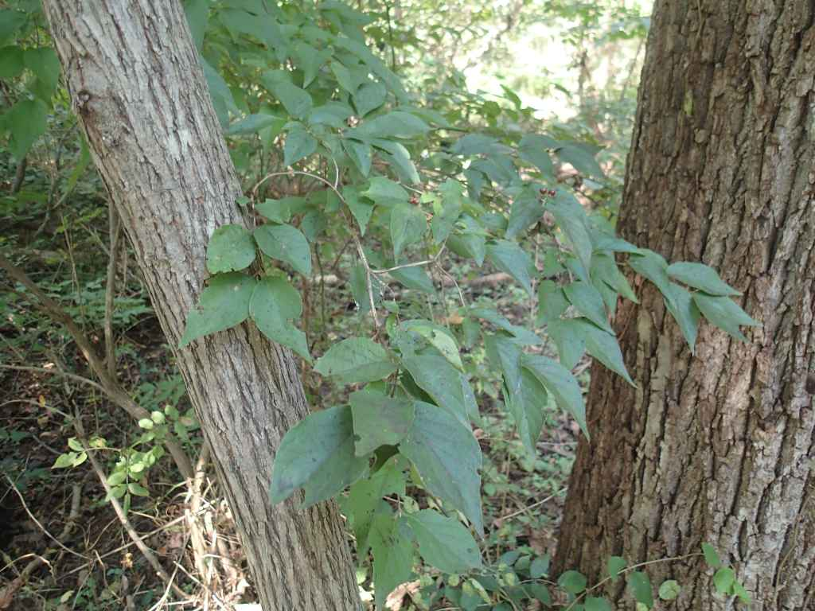
Devil’s Walking Stick
Family name→ Araliaceae
Genus→ Aralia
Species→Spinosa
Identification tips→ Two leaf clusters, ridged, reverse teardrop shaped leaves, spiney stems

Slide 3
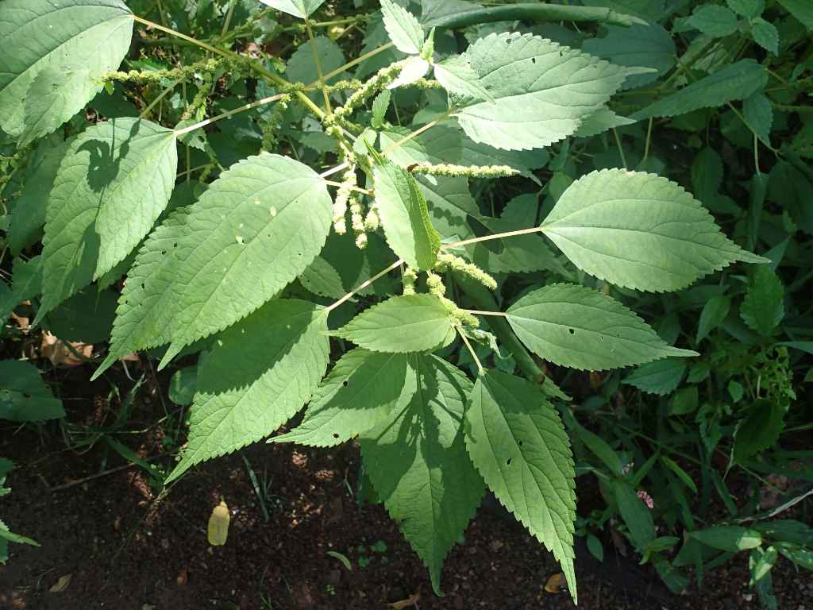
Smallspike False Nettle
Family name→ Urticaceae
Genus→ Boehemeria
Species→ Cylindrica
Identification tips→ Ridged, reverse teardrop shaped leaves, smooth stems

Slide 4
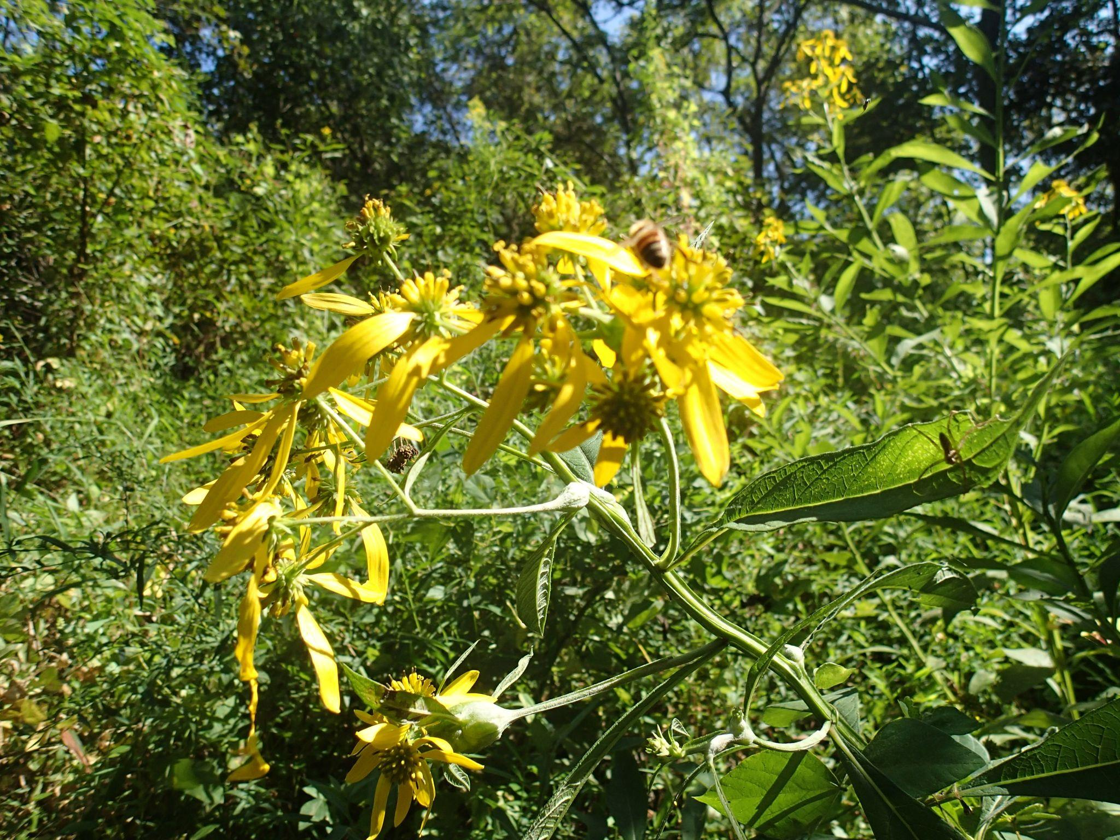
Wingstem/ Yellow Ironweed
Family name→ Asteraceae
Genus→ Verbesina
Species→Alternifolia
Identification tips→ Leafy plants with yellow, thin petaled flowers in clusters

Slide 5
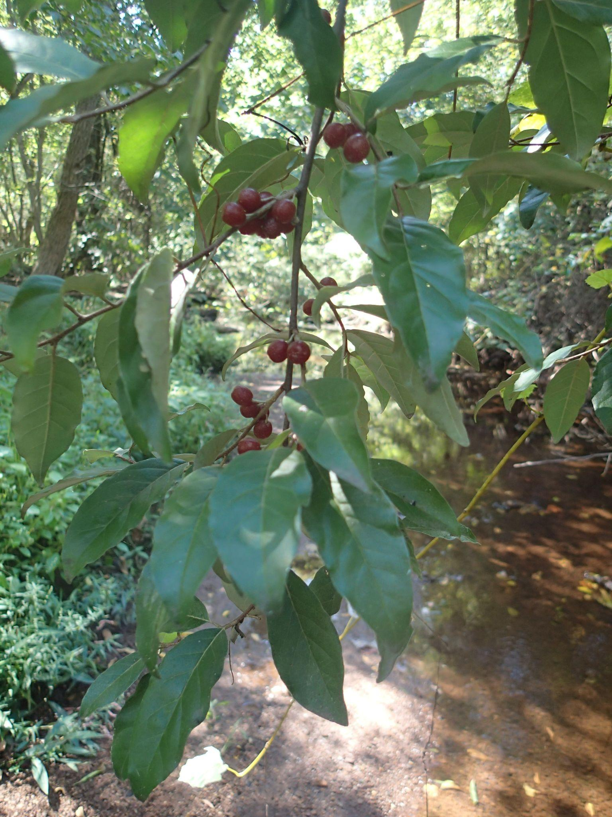
Autumn Olive
Family name→ Elaeagnaceae
Genus→ Elaeagnus
Species→Umbellata
Identification tips→ Smooth, reverse teardrop shape, smooth edges, Green outer appearance, lighter undershade, red berries (summer-fall)

Slide 6
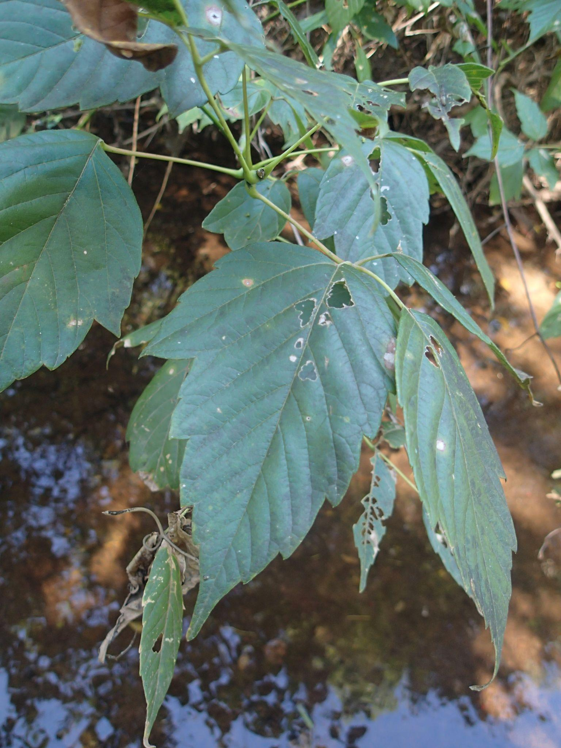
Boxelder Tree
Family name→ Sapindaceae
Genus→ Acer
Species→Negundo
Identification tips→ Leaves clustering in 3s, 3-5 lobes, distinct edges

Slide 7
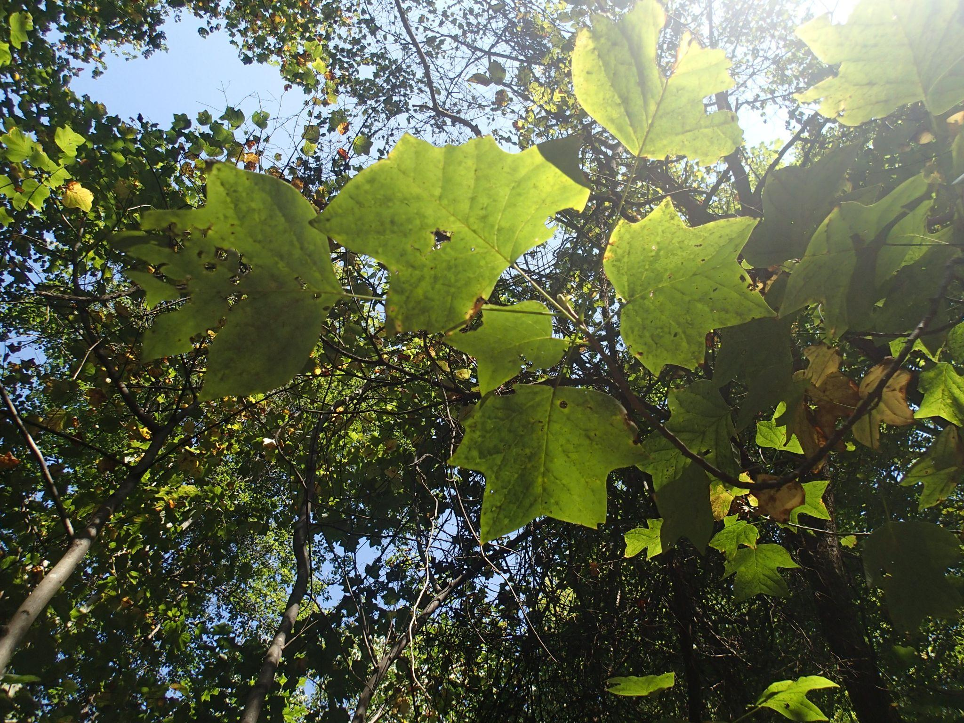
Tulip Poplar
Family name→ Magnoliaceae
Genus→ Liriodendron
Species→Tulipifera
Identification tips→ 4 Pointy, v shaped lobes, sparse

Slide 8
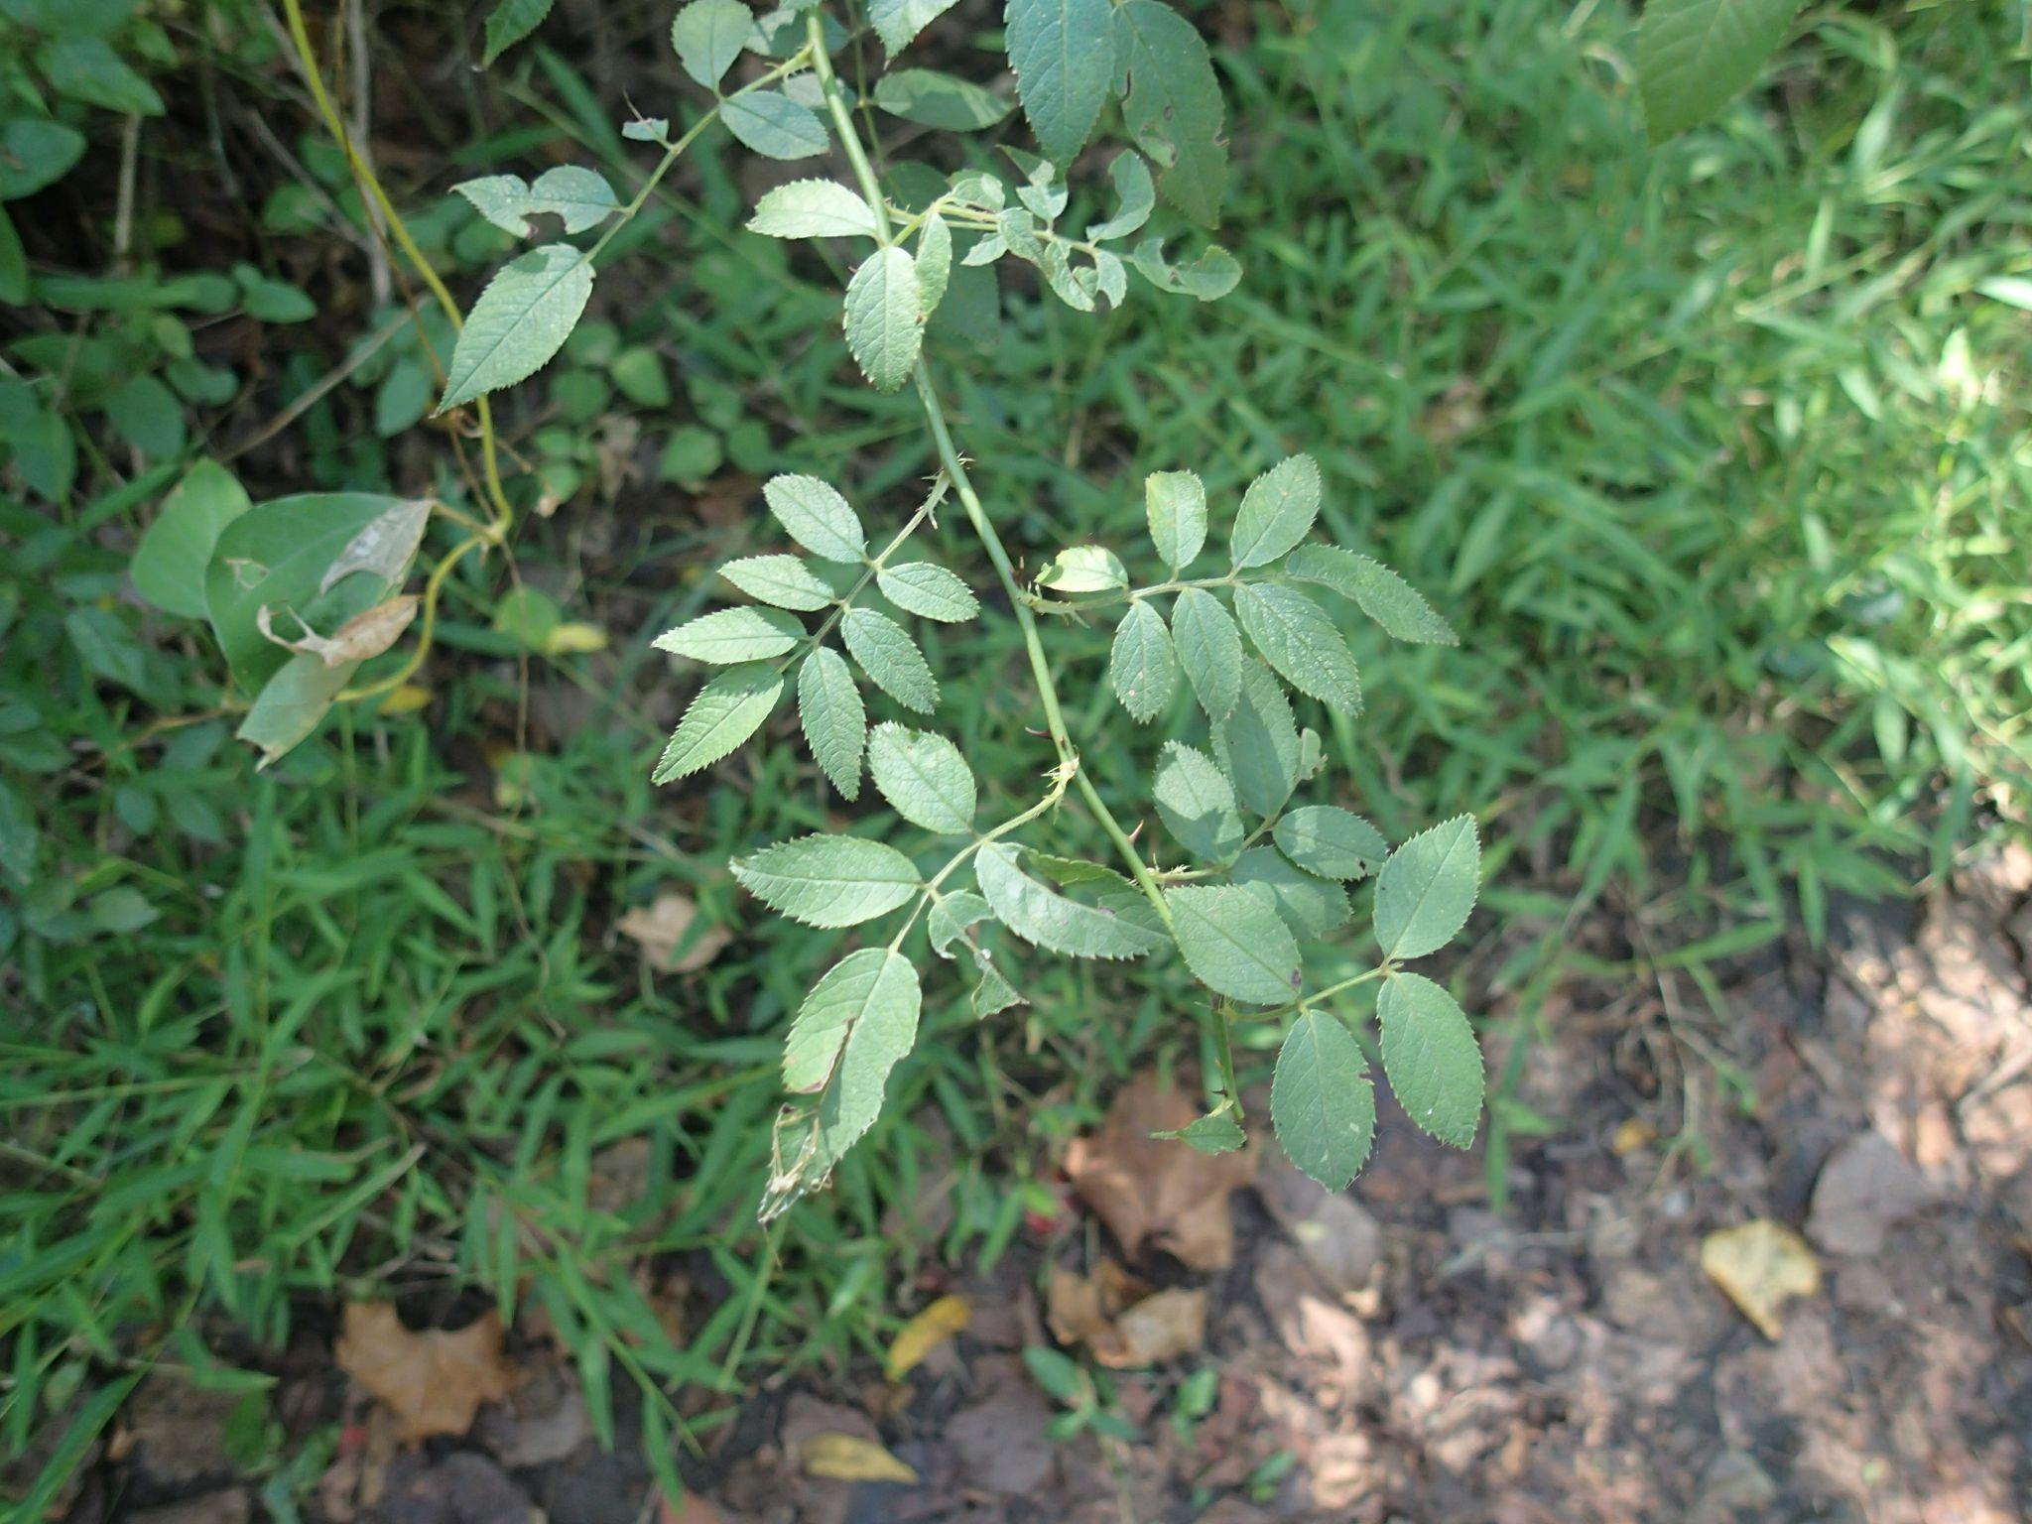
Multiflora Rose
Family name→ Rosaceae
Genus→ Rosa
Species→ Multiflora
Identification tips→ Spikey stems, small, reverse teardrop, ridged shaped leaves, grow in sparse clusters

Slide 9
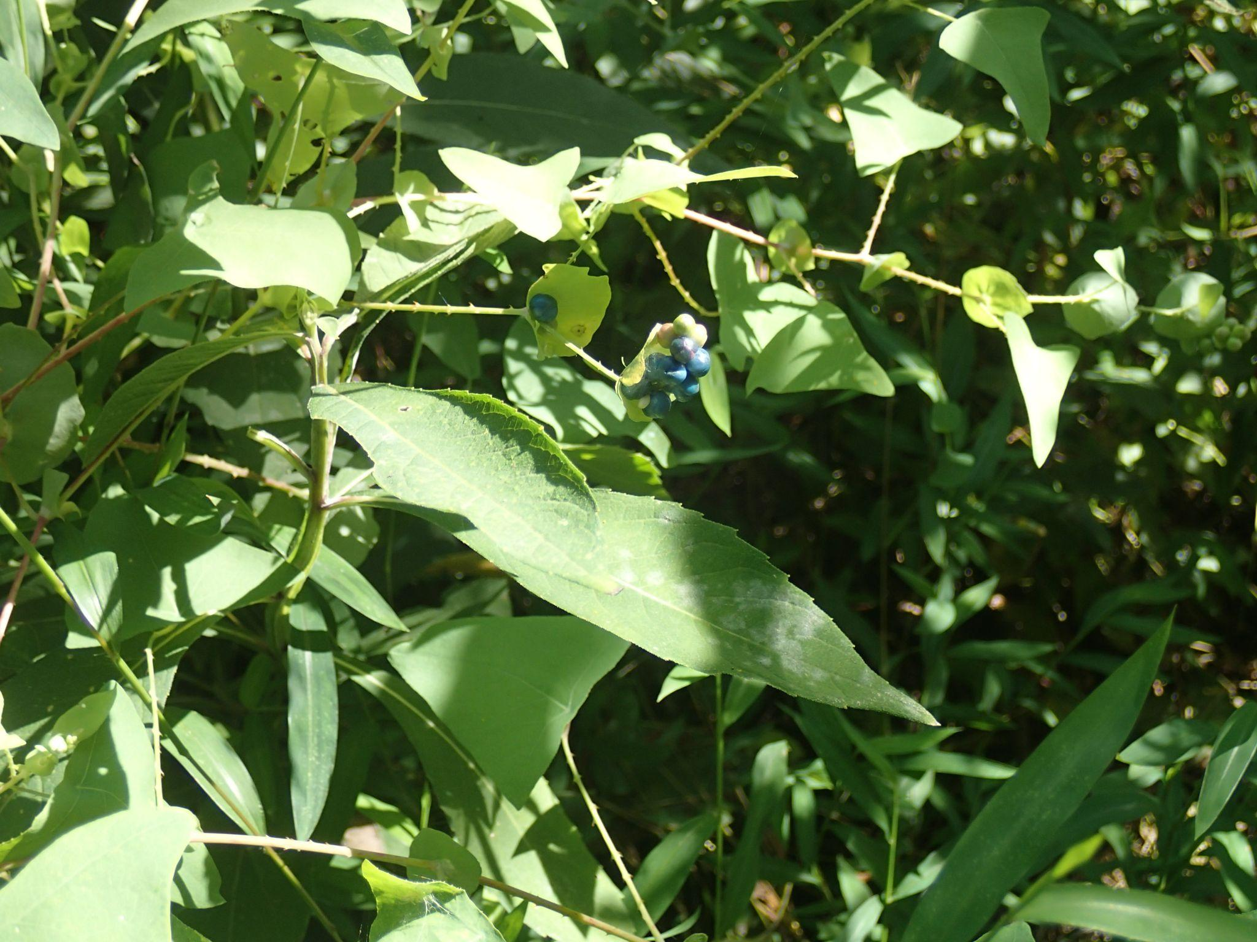
Mile-A-Minute Weed
Family name→ Polygonaceae
Genus→ Persicaria
Species→ Perfoliata
Identification tips→Redish, spikey stems, indiv. shark tooth shaped leaves, dark blue berries

Slide 10
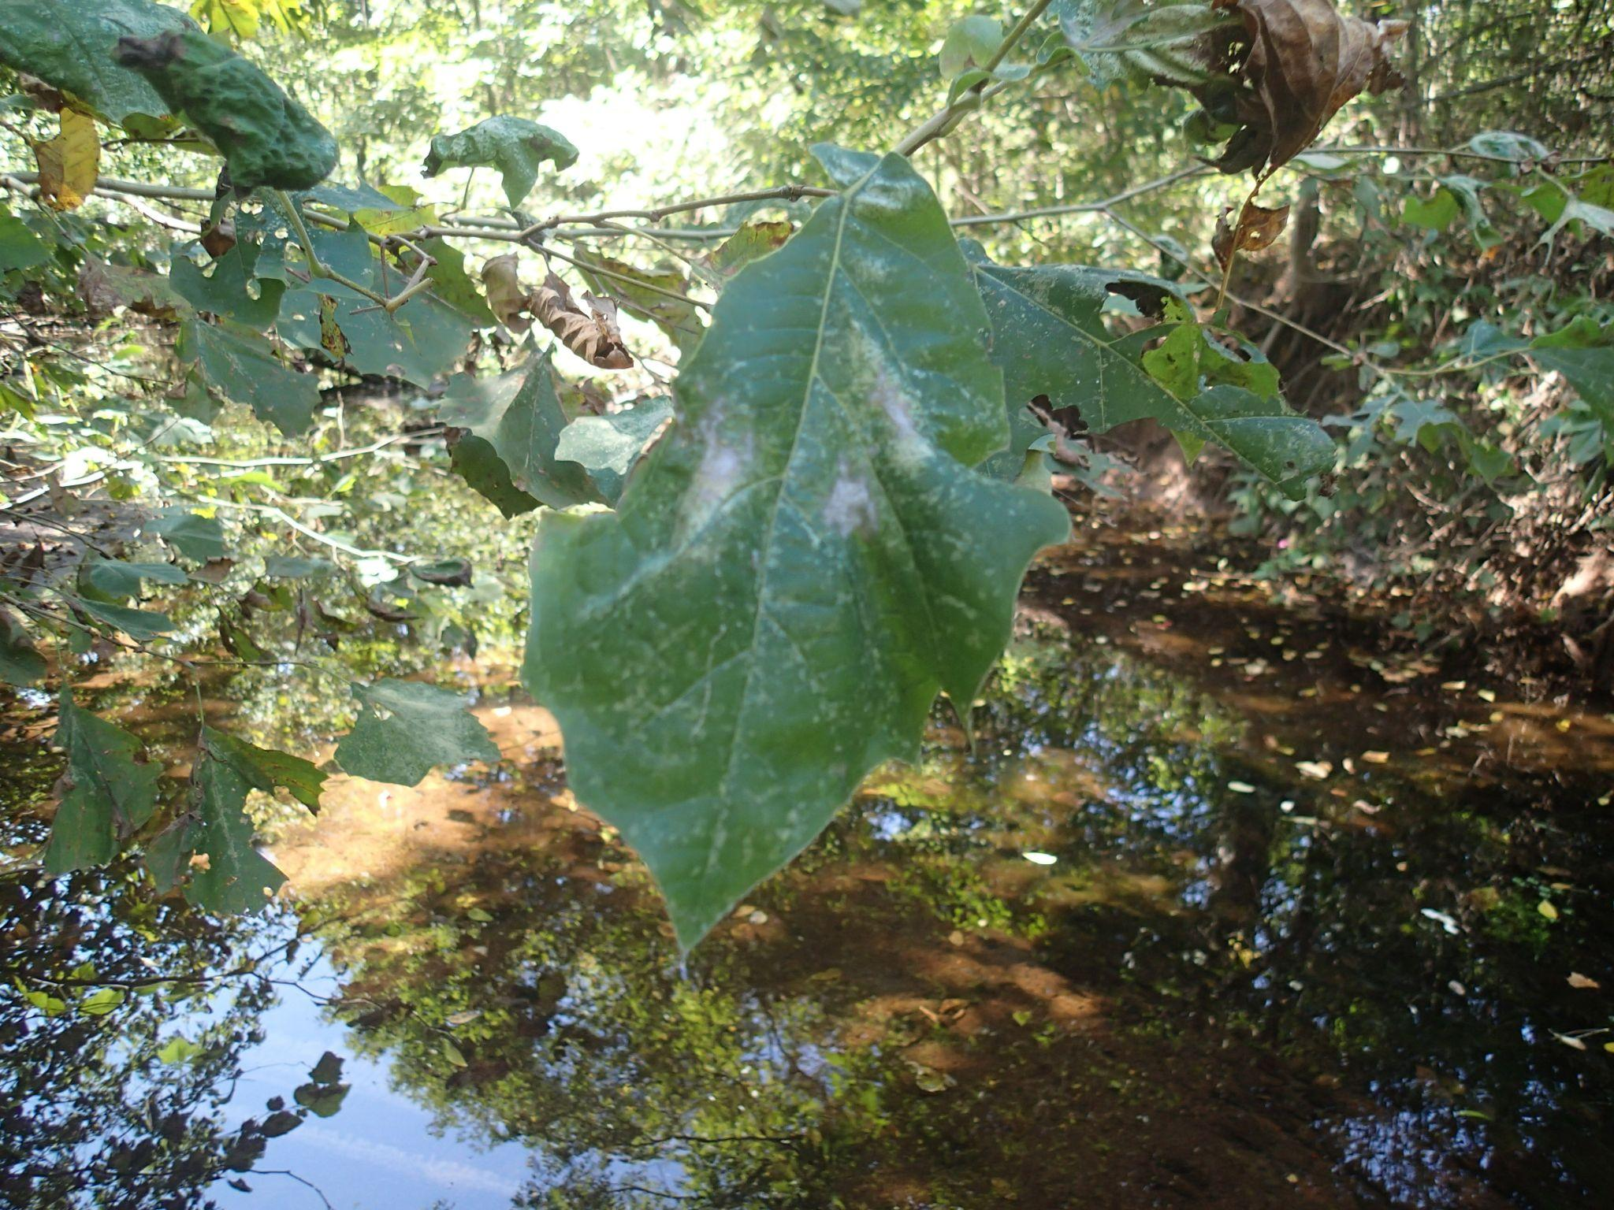
Blackjack Oak
Family name→ Fagaceae
Genus→ Quercus
Species→ Marilandica
Identification tips→ 3-5, smooth edge lobes, similar to a Y or a T, dark, and rough tree bark

Slide 11
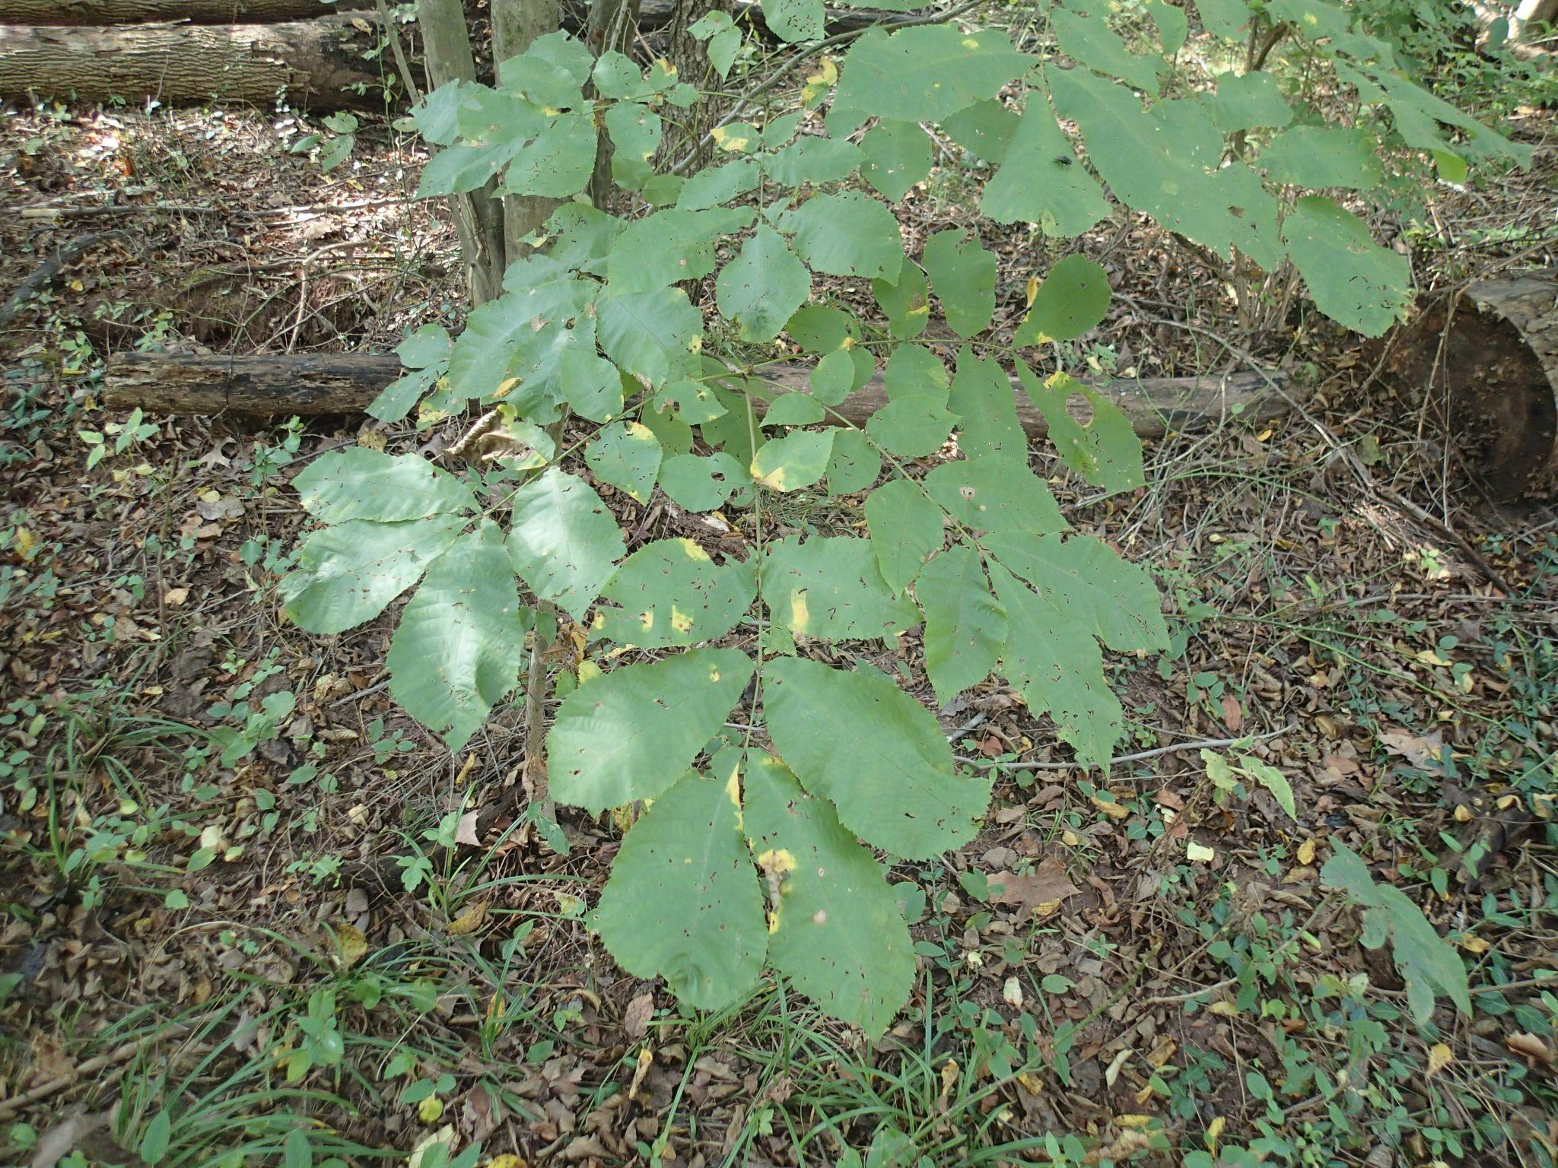
Mockernut Hickory
Family name→ Juglandaceae
Genus→ Carya
Species→ Tomentosa
Identification tips→ Oval shaped leaves, grows in 2-4 leaf clusters, ridged edges, smooth stems

Slide 12
References
New York Floral Association. (n.d.). New York Floral Atlas. Advanced Search - NYFA: New York Flora Atlas. https://newyork.plantatlas.usf.edu/search.aspx
Sanfield, S. (2025). Horsepen Run Trailhead Trees and Shrubs. photograph, Horsepen Run Trailhead.
VT Dendrology. (n.d.). Virginia Tech Dendrology Factsheets. Dendro.cnre.vt.edu. https://dendro.cnre.vt.edu/dendrology/factsheets.cfm

