Slide 1
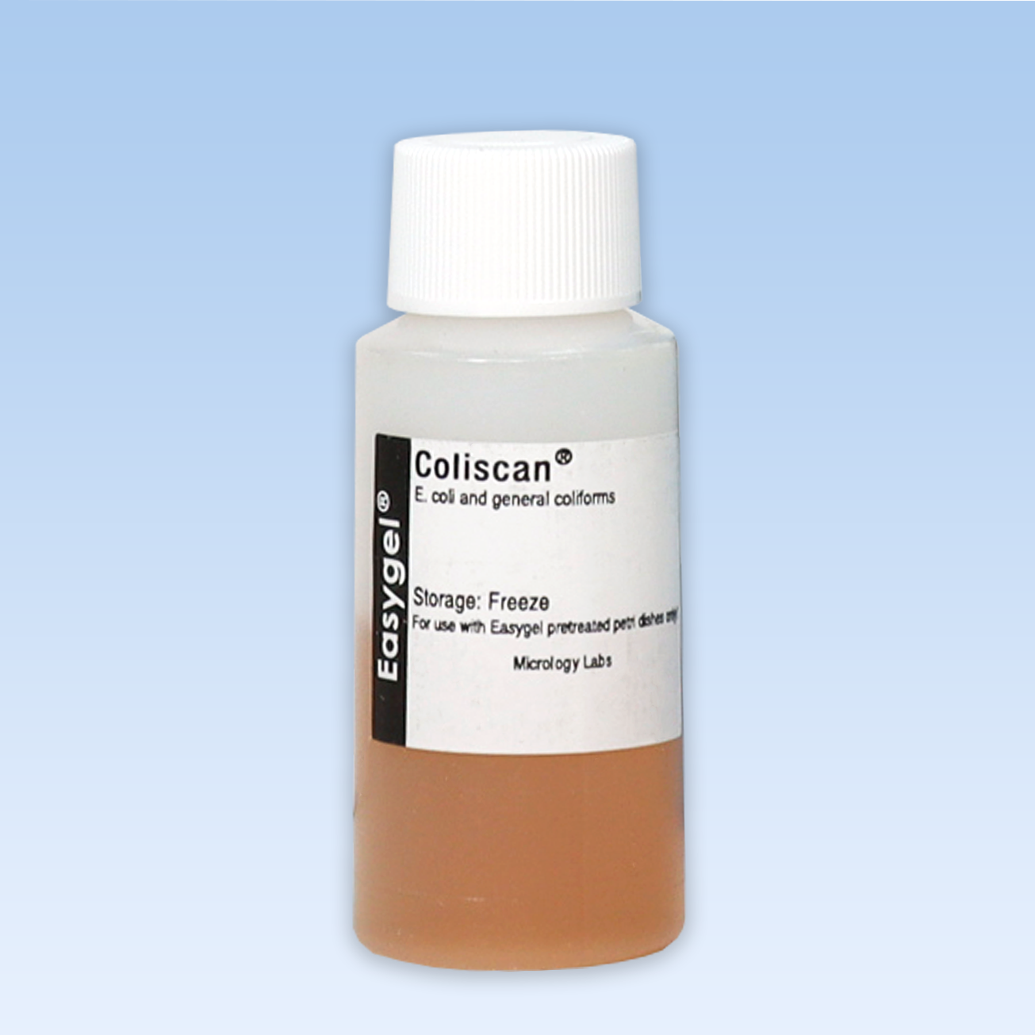
Coliscan Easygel

Slide 2
Companies Providing this Equipment
Micrology Laboratories
Forestry Supplies
Weber Scientific
Dabos
Midland Scientific Inc.

Slide 3
What does it do?
Coliscan Easygel is a tool to test the water samples of lakes, streams, and rivers. Specifically, it tests for different bacterias, such as Coliform and E. Coli. These tests whether a body of water is contaminated and if it poses possible health risks.
The test is accessible enough that it can be used within your own home, and not just a lab setting!

Slide 4
How Does it Work?
Coliscan is relatively simple to use. You are going to need a petri dish for your sample, the water source you would like to test, as well as the Coliscan Easygel.
You are going to put the gel into the petri dish, then add your sample. If you are doing it at home, set your sample on top of your refrigerator overnight, or let the sample incubate, ideally somewhere warm.
If there is bacteria present in your sample, two colors will reveal what is there. If you see pink in your sample, it means you have coliform, and if you have purple it means your sample has E. Coli. If it is clear, the water is not contaminated.

Slide 5
Why Coliscan Easygel?
Compared to older testing methods, it is efficient, practical, and it narrows down testing in looking for specific enzymes that these two bacterias make.
Older testing methods requires using lactose, and with under careful incubation it looked for gas production signifying lactose fermentation, then extra media would have to be added to indicate the bacterial presence. This process requires extra equipment and time, and money, in comparison to newer methods such as Coliscan Easygel.
Other water testing methods are narrow in what water is being used; some water testing is mainly for drinking water or tap water

Slide 6
References
Micrology Labs. (2020, May 14). Coliscan Easygel. https://www.micrologylabs.com/coliscan-easygel /

